Slide 1
Sustainability Capstone:
Decarbonising Travel
Where Celonis' carbon footprint actually comes from — and the quick wins hiding in the process data.
Speaker name: Soumadipta Konar
Institute: IIEST Shibpur
Branch & Year of Study: IT(UG 2nd year)
Email ID: soumadipta.konar2005@gmail.com

Slide 2
Executive Summary
Celonis' business travel emitted an estimated 114,300 tCO2e/year (annualized from 65,289 trips over the ~18-month dataset), costing $90.2M/year.
Top 3 insights:
1. Asia-Pacific departure hubs drive 66% of all emissions despite being ~47% of trips
2. trips booked within 14 days of departure are out-of-policy 90% of the time, vs. 7% for trips booked on time;
3. the top quartile "high-carbon" trips (25% of trips) generate 59% of emissions — at virtually the same average cost as low-carbon trips ($2,142 vs. $2,155).
Recommendations:
Shift the Beijing–Moscow flight corridor to rail.
Enforce the 14-day booking policy at the point of booking.
Default premium-cabin bookings to economy where a low-carbon option costs the same.
Project Impact:
Quantified per recommendation on Slide 6 — combined quick wins exceed 6,000 tCO2e/year at near-zero net cost.

Slide 3
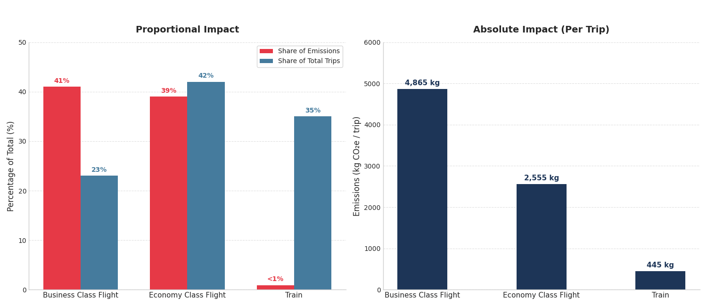
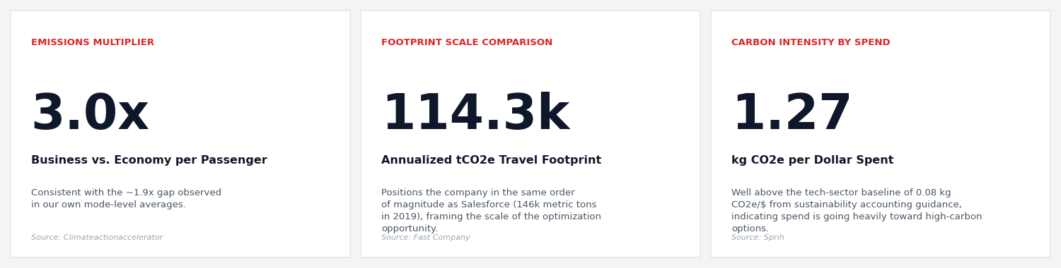
Emissions Profile and Benchmarking
Total: 114,300 tCO2e/yr, $90.2M/yr, ~2.06 tCO2e/employee/yr.
By mode: Business Class Flights are 41% of emissions from just 23% of trips (avg 4,865 kg/trip); Economy Flights 39% of emissions from 42% of trips (avg 2,555 kg/trip); Train is <1% of emissions despite serving comparable routes (avg 445 kg/trip).
Benchmarking:

Slide 4
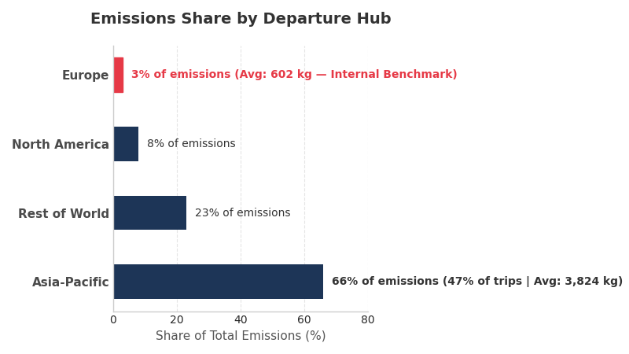
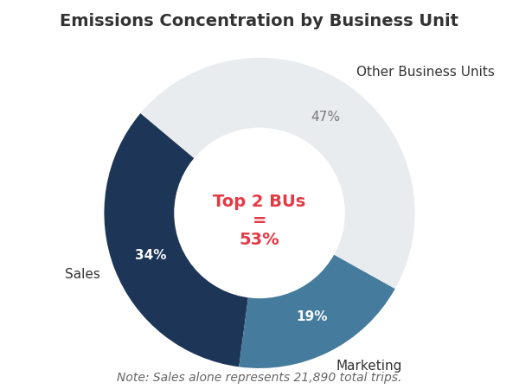
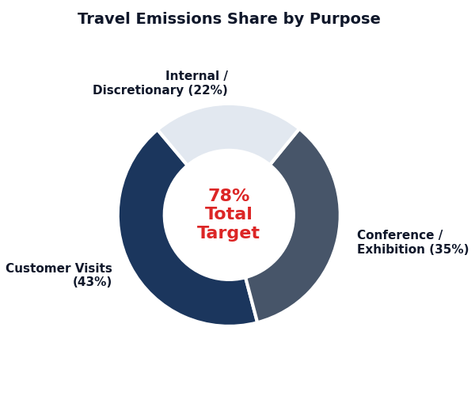
Hotspot Analysis
Region (by departure hub):
Asia-Pacific 66% of CO2 / 47% of trips (3,824 kg/trip avg)
North America 8%
Europe just 3% (602 kg/trip avg — the benchmark for what "good" looks like internally).
Rest of World 23%
Business Unit:
Purpose:
Sales alone = 34% of emissions (21,890 trips)
Marketing 19%
Combined top 2 BUs = 53% of footprint.
Customer Visits 43% of emissions
Conference/Exhibition 35%
Internal Travel 22%

Slide 5
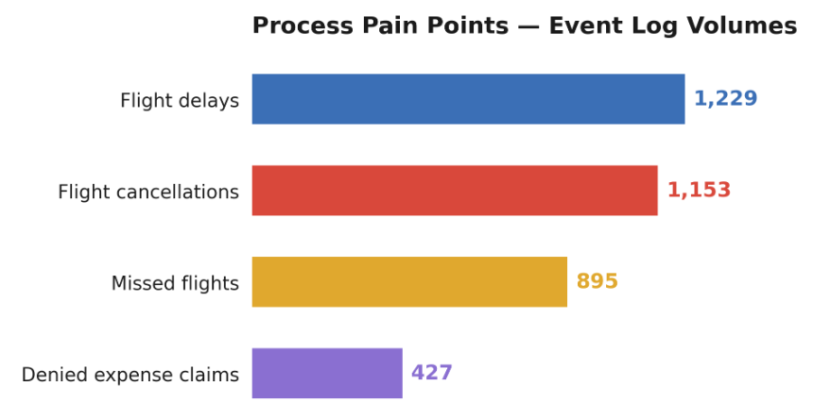
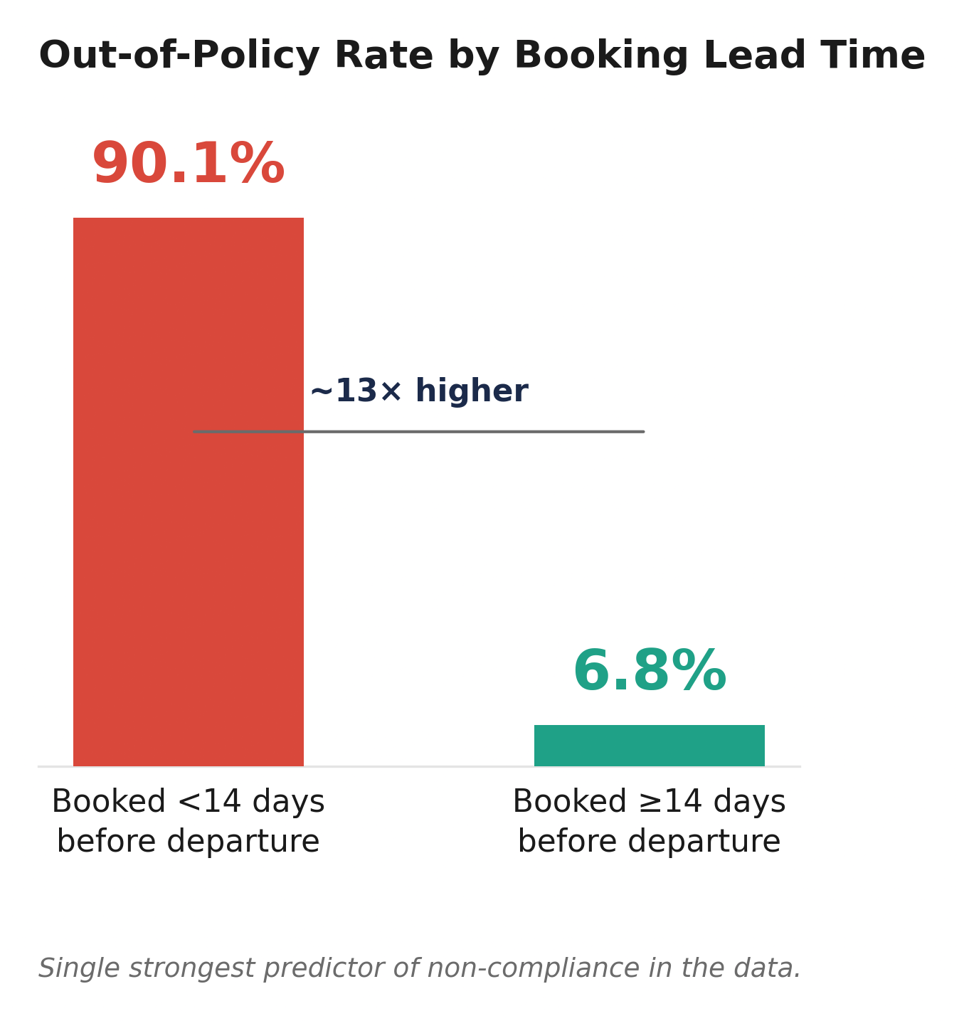
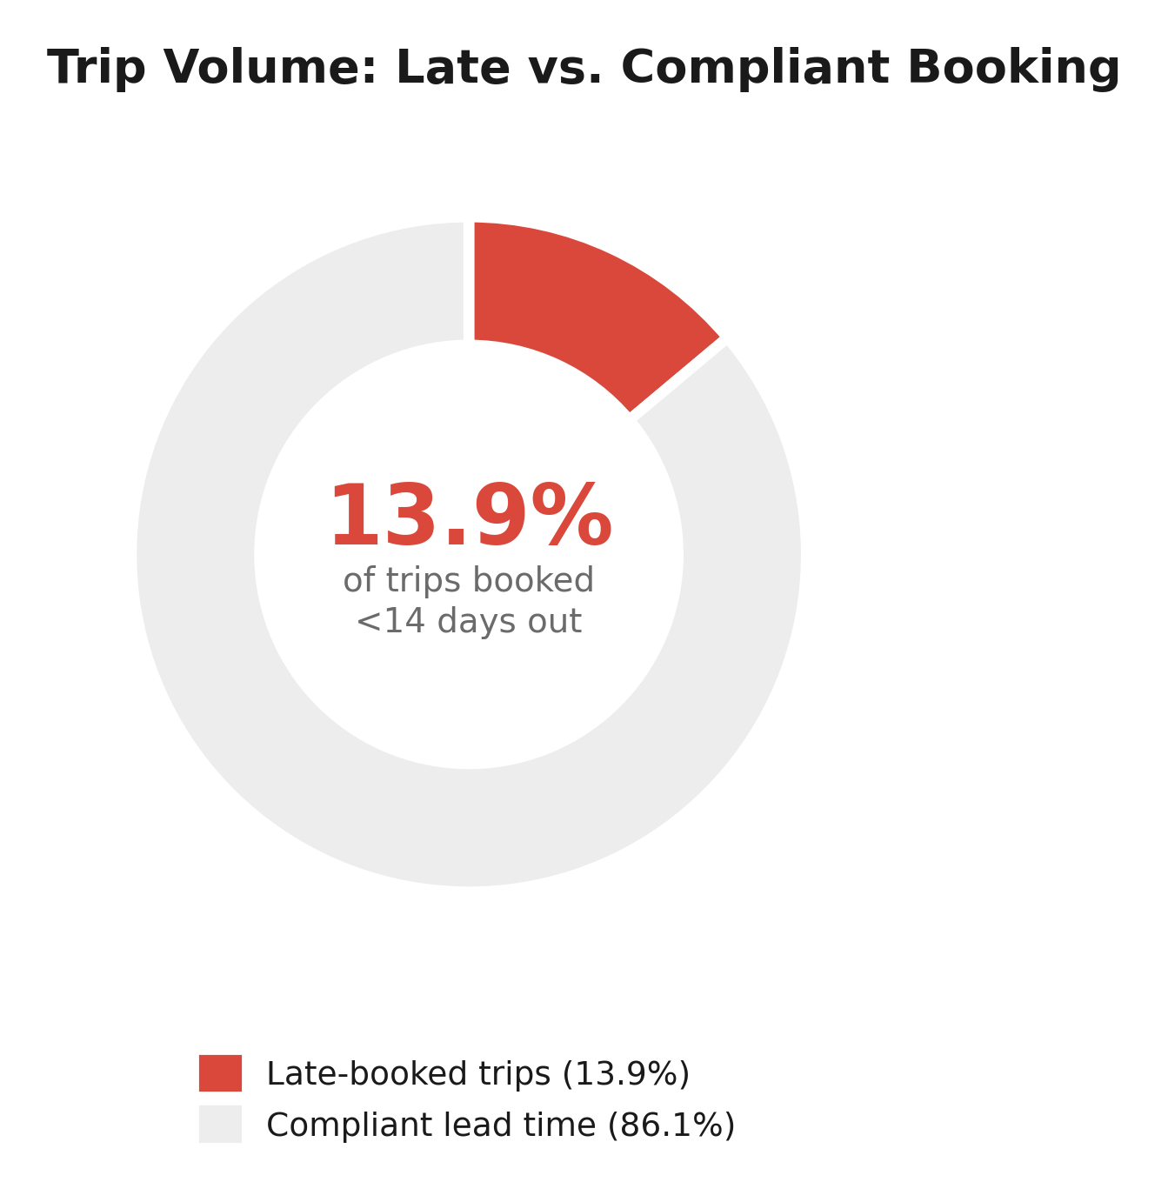
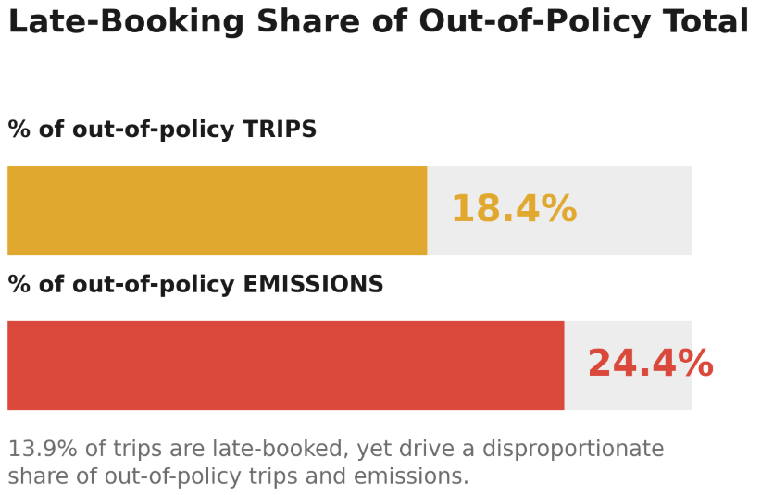
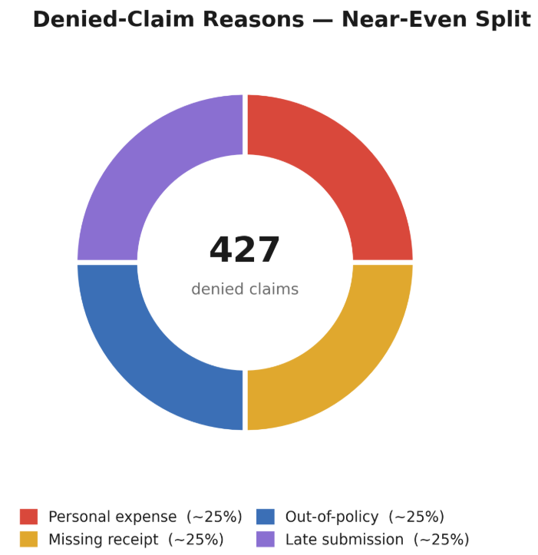
Inefficiencies Identified
Late booking → policy breach: trips booked <14 days before departure are out-of-policy 90.1% of the time vs. 6.8% for compliant lead times — this is the single strongest predictor of non-compliance in the data.
Only 13.9% of trips are booked within that late window, but they account for a disproportionate share of the 18.4%-of-trips / 24.4%-of-emissions out-of-policy total.
Process pain points from the event log: 1,153 flight cancellations, 1,229 flight delays, 895 missed flights, 427 denied expense claims (top denial reasons: personal expense, missing receipt, out-of-policy, late submission — each ~25% of denials).
Conformance note:
The Navan booking sequence (transport must be booked before the request is formally submitted) is worth flagging in the Process Explorer as a system-driven variant, not a behavioral one.

Slide 6
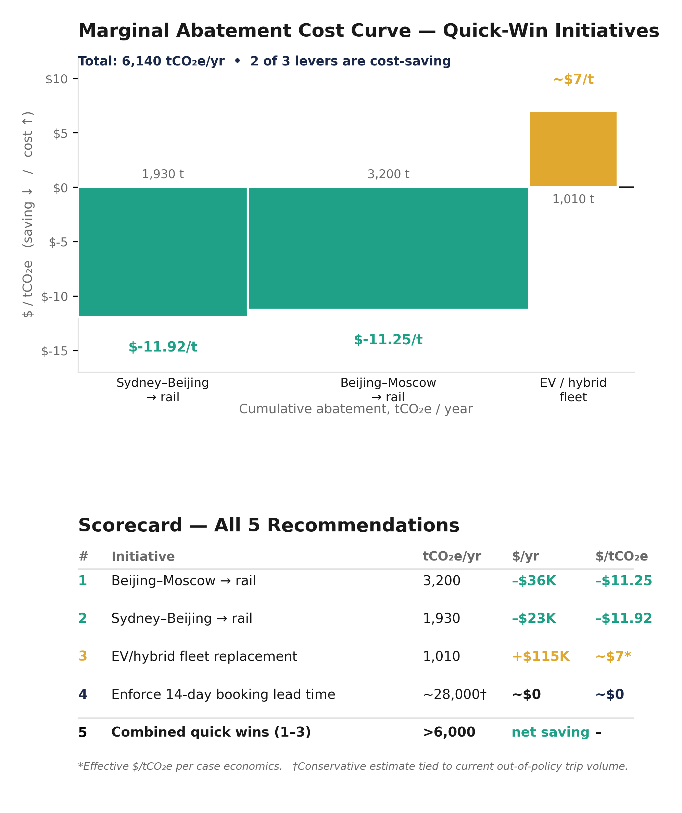
Low Carbon Strategic Recommendations (Quantified)
.
Shift Beijing–Moscow flights to rail (route already has a working train alternative): saves ~3,200 tCO2e/year and ~$36K/year.
Shift Sydney–Beijing flights to rail: saves ~1,930 tCO2e/year and ~$23K/year.
Replace remaining diesel/petrol fleet cars with EV/hybrid: saves ~1,010 tCO2e/year for a ~$115K/year premium (~$7/tCO2e — cheap relative to market carbon credit prices).
Enforce 14-day booking lead time at point-of-booking: directly addresses the trips driving the 90% out-of-policy rate; conservatively targets the ~28,000 tCO2e/year currently tied to out-of-policy trips.
Combined quantified quick wins: >6,000 tCO2e/year, most at cost-neutral or cost-saving terms.

Slide 7
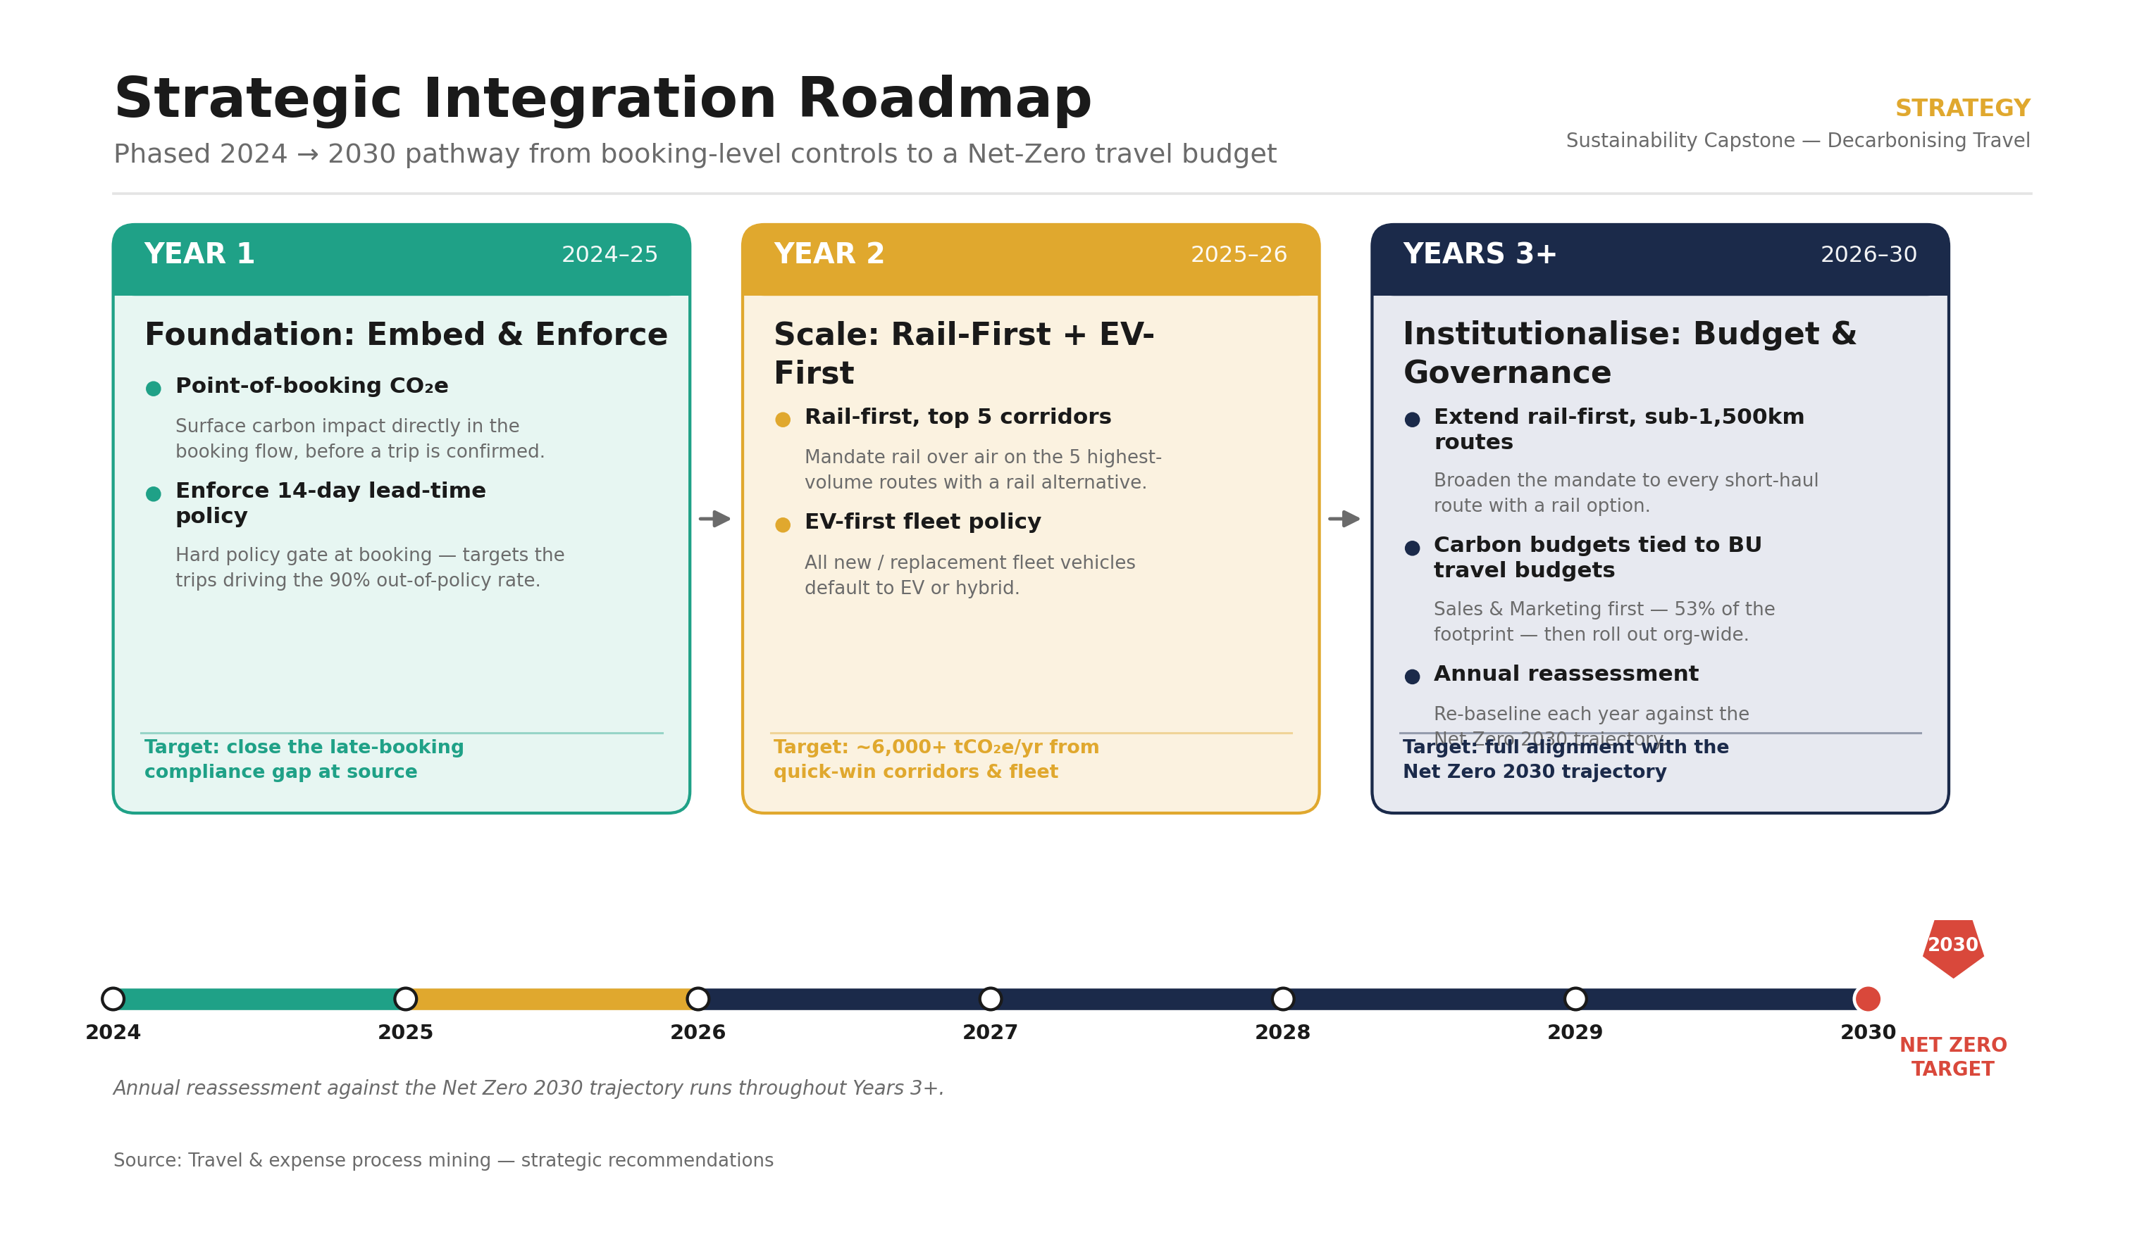
Roadmap
.

Slide 8
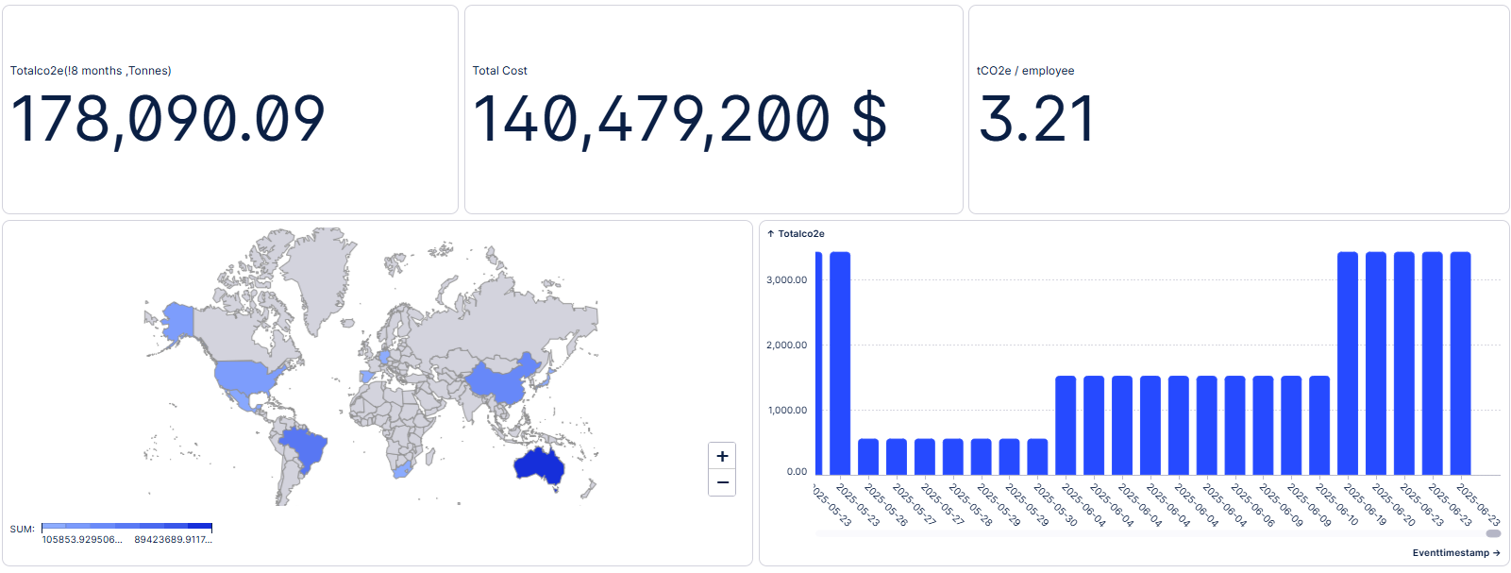
Dashboard 1: Emmision Overview

Slide 9
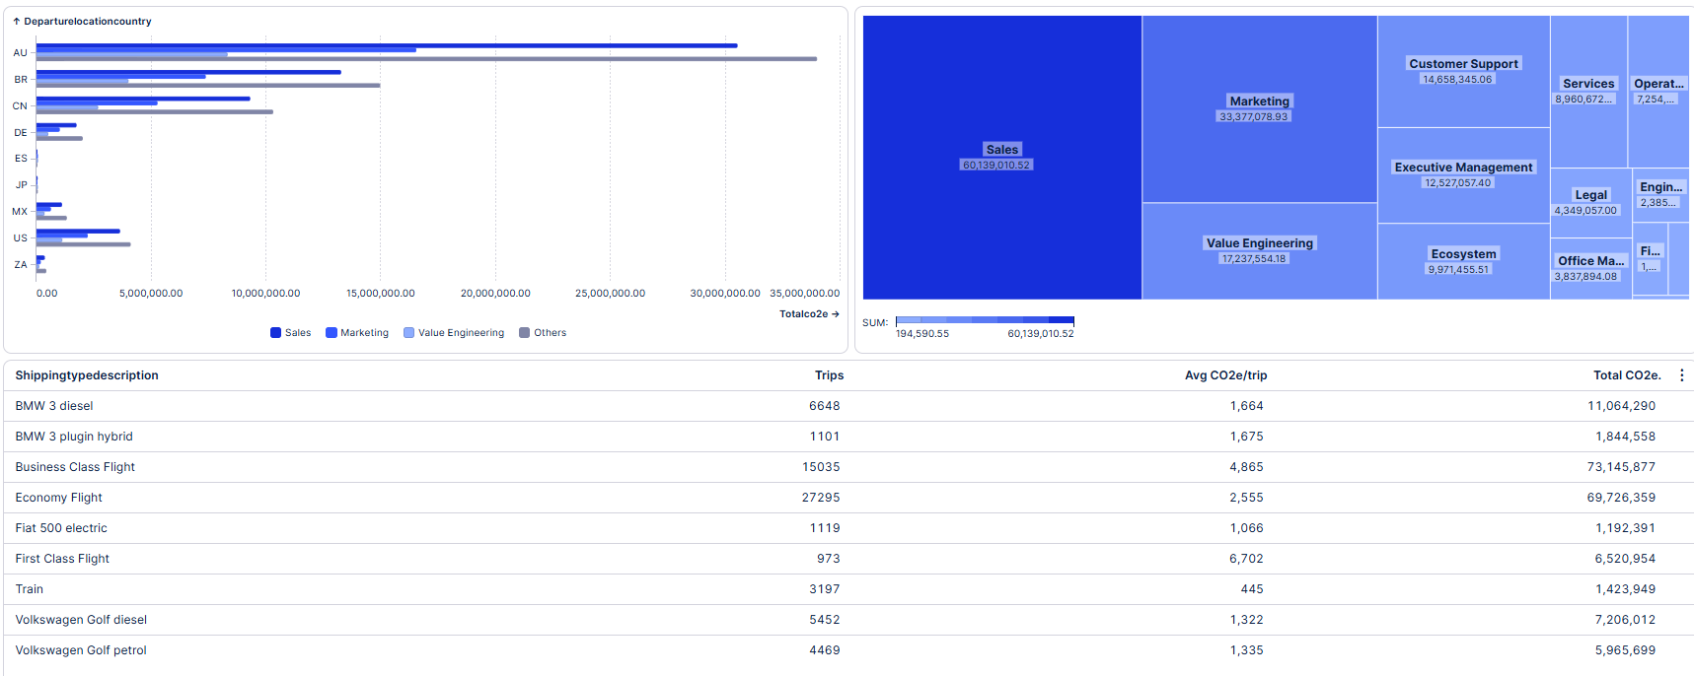
Dashboard 2:Benchmarking

Slide 10
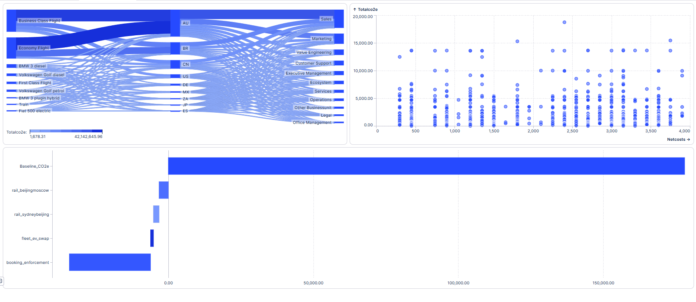
Dashboard 3 : Emissions drilldown

